Slide 1
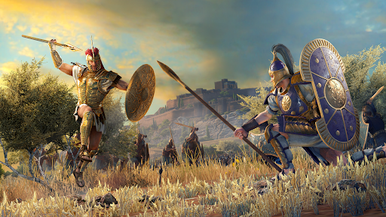
Survey analysis week 1 “the inference wars”
© Peter Lugtig

Slide 2
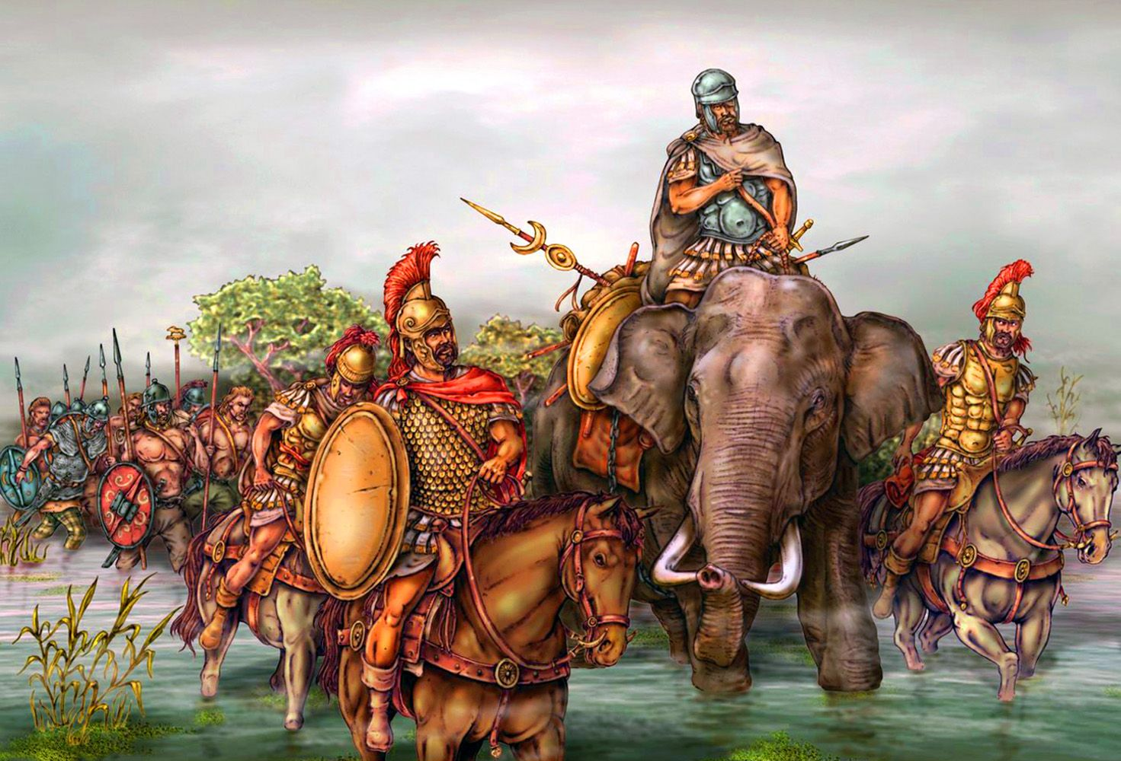
Outline for today
Introduction
Surveys and samples
The first inference war:
1948~1960
The second inference war:
2005~2020
Election polling
Class exercise

Slide 3
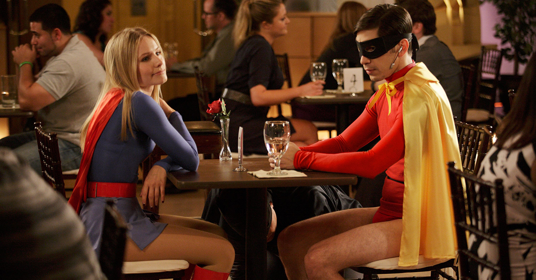
But first: Speed-dating!
Form 2 rows of 10 people
Ask 1 question (1 min max)
Get 1 in return (1 min max)
Row facing the Screen: shift one place on signal
https://www.youtube.com/watch?v=2dAorgAB0I4

Slide 4
Survey data analysis
A method to acquire information by asking people selected from a predefined group questions in a structured manner
Dominant method of collecting data in the social and behavorial sciences
Learn about the methodology of conducting the survey

Slide 5
Survey data analysis
A method to acquire information by asking people selected from a predefined group questions in a structured manner
Survey data analysis
Sampling
Inference
Doing this for all kinds of methods

Slide 6
Why focus on Sampling?
Basis of all inferential statistics
Standard error in t-test, Anova, regression.
Sampling errors can be estimated
Design based inference
(model-based inference later in course)
Power analysis, efficient design of studies
Important in understanding other techniques (e.g. Bootstrapping)
There are not so many people who know about this
A specific skill ‘survey statistics’

Slide 7
Links to other courses
Multivariate Statistics
Fundamentals of Statistics
Computation inference with R
Survey data analysis:
Links/overlap
Apply the general linear model under correct inferential design
Apply fundamental knowledge about estimators
Apply R skills to analyse a real-life dataset and data problem
Specific goals: inference, data collection, missing data

Slide 8
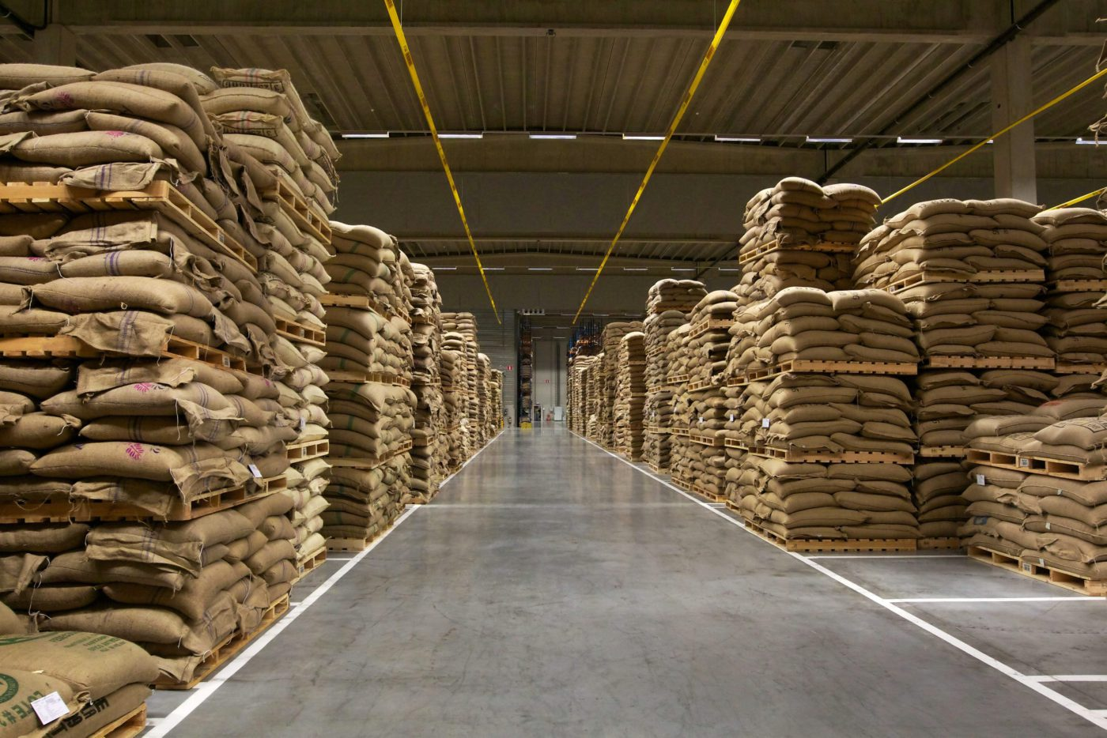
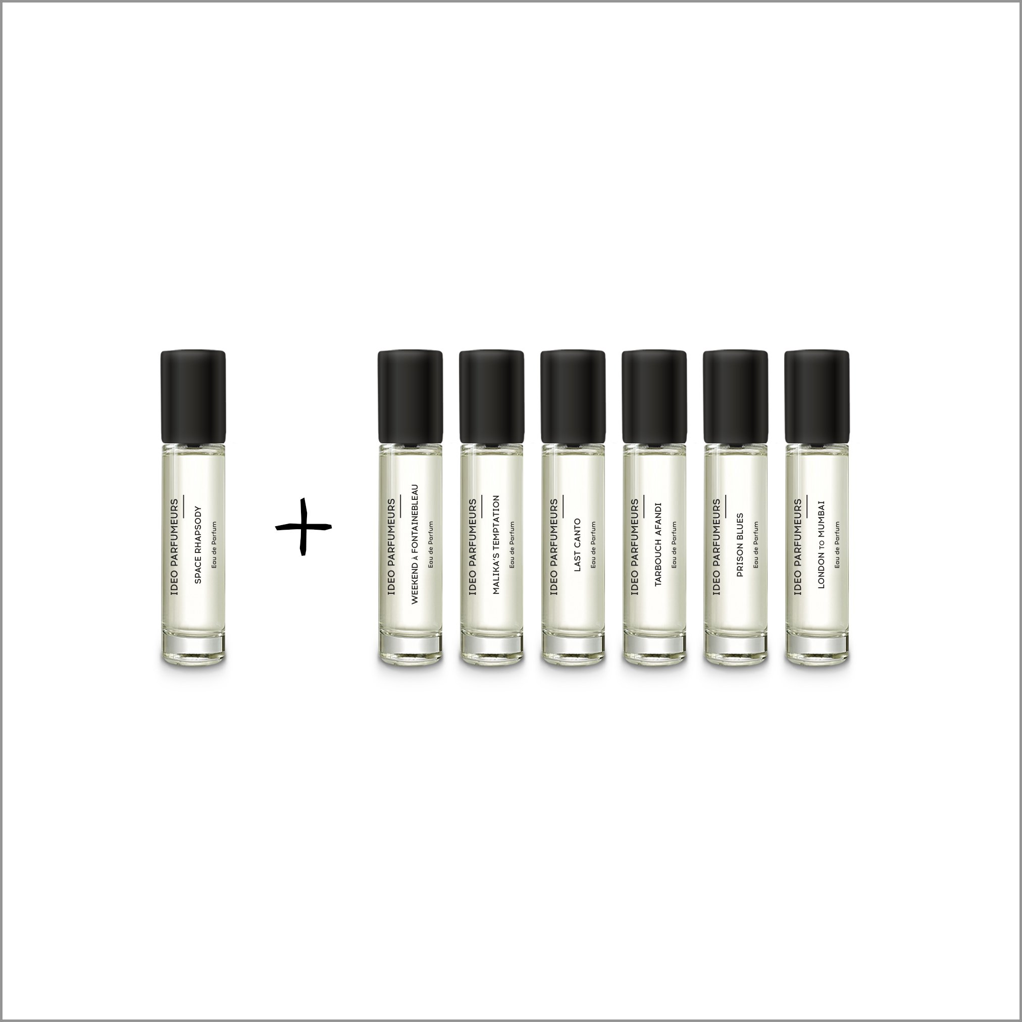
Sample
NL: steekproef
DE: stichprobe
FR: Échantillon
ES: muestra

Slide 9
The first inference war (1936-1952)

Slide 10
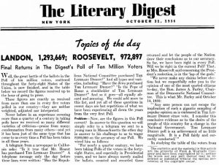
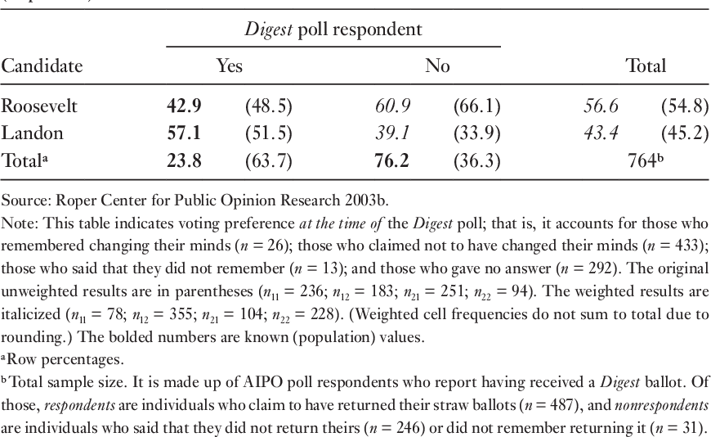
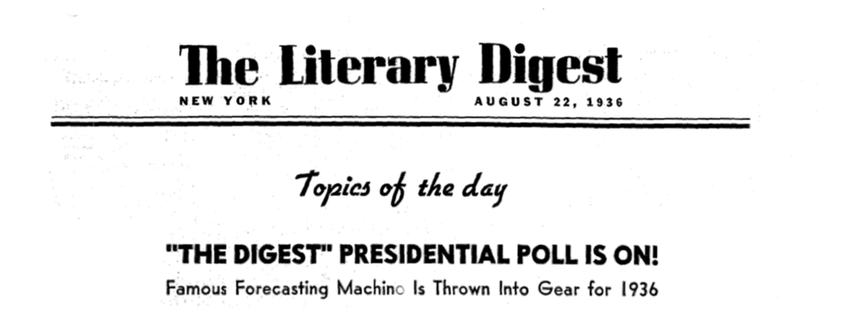
The 1936 Literary Digest survey
Correct result since 1916
Sample: 2.4 million people(!)
Opt-in sample
The literary Digest

Slide 11
The 1936 Literary Digest survey
Sample: 2.4 million people(!)
Opt-in sample
The literary Digest

Slide 12

1936-1948: Quota Sampling
Opt-in sample, but:
Record characteristics that are important for voring behavior.
We want a sample of 1000 respondents
Quota:
White, male, aged 35-54, blue collar worker 5% of population -> 50 in sample
Black, female, aged 18-35, in education 2% of population -> 20 in sample
….
Choice of variables for quota is important!
Why does this go wrong in election polling? -------->

Slide 13
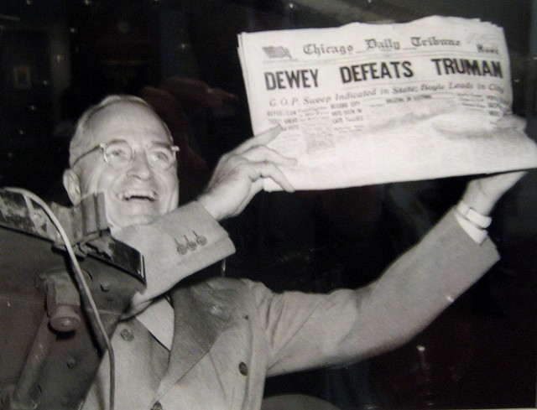
1948: Truman vs. Dewey
Gallup, Roper
Quota sample
Prediction: +5 for Dewey
Result: +5 for Truman
Problem with quotas
Gender, age, race
Late undecideds

Slide 14
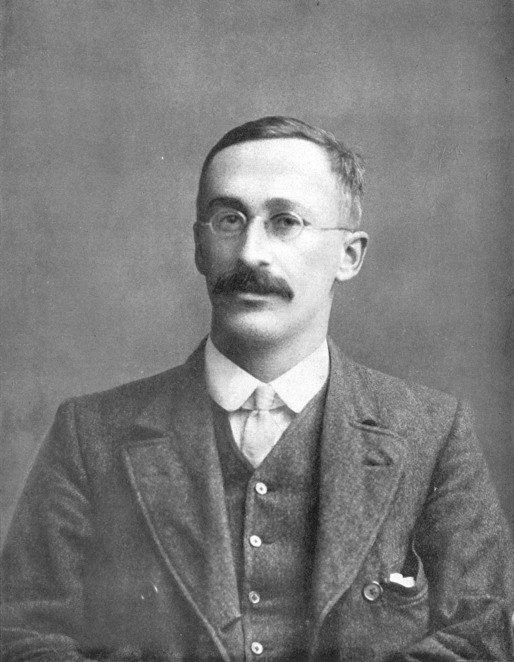
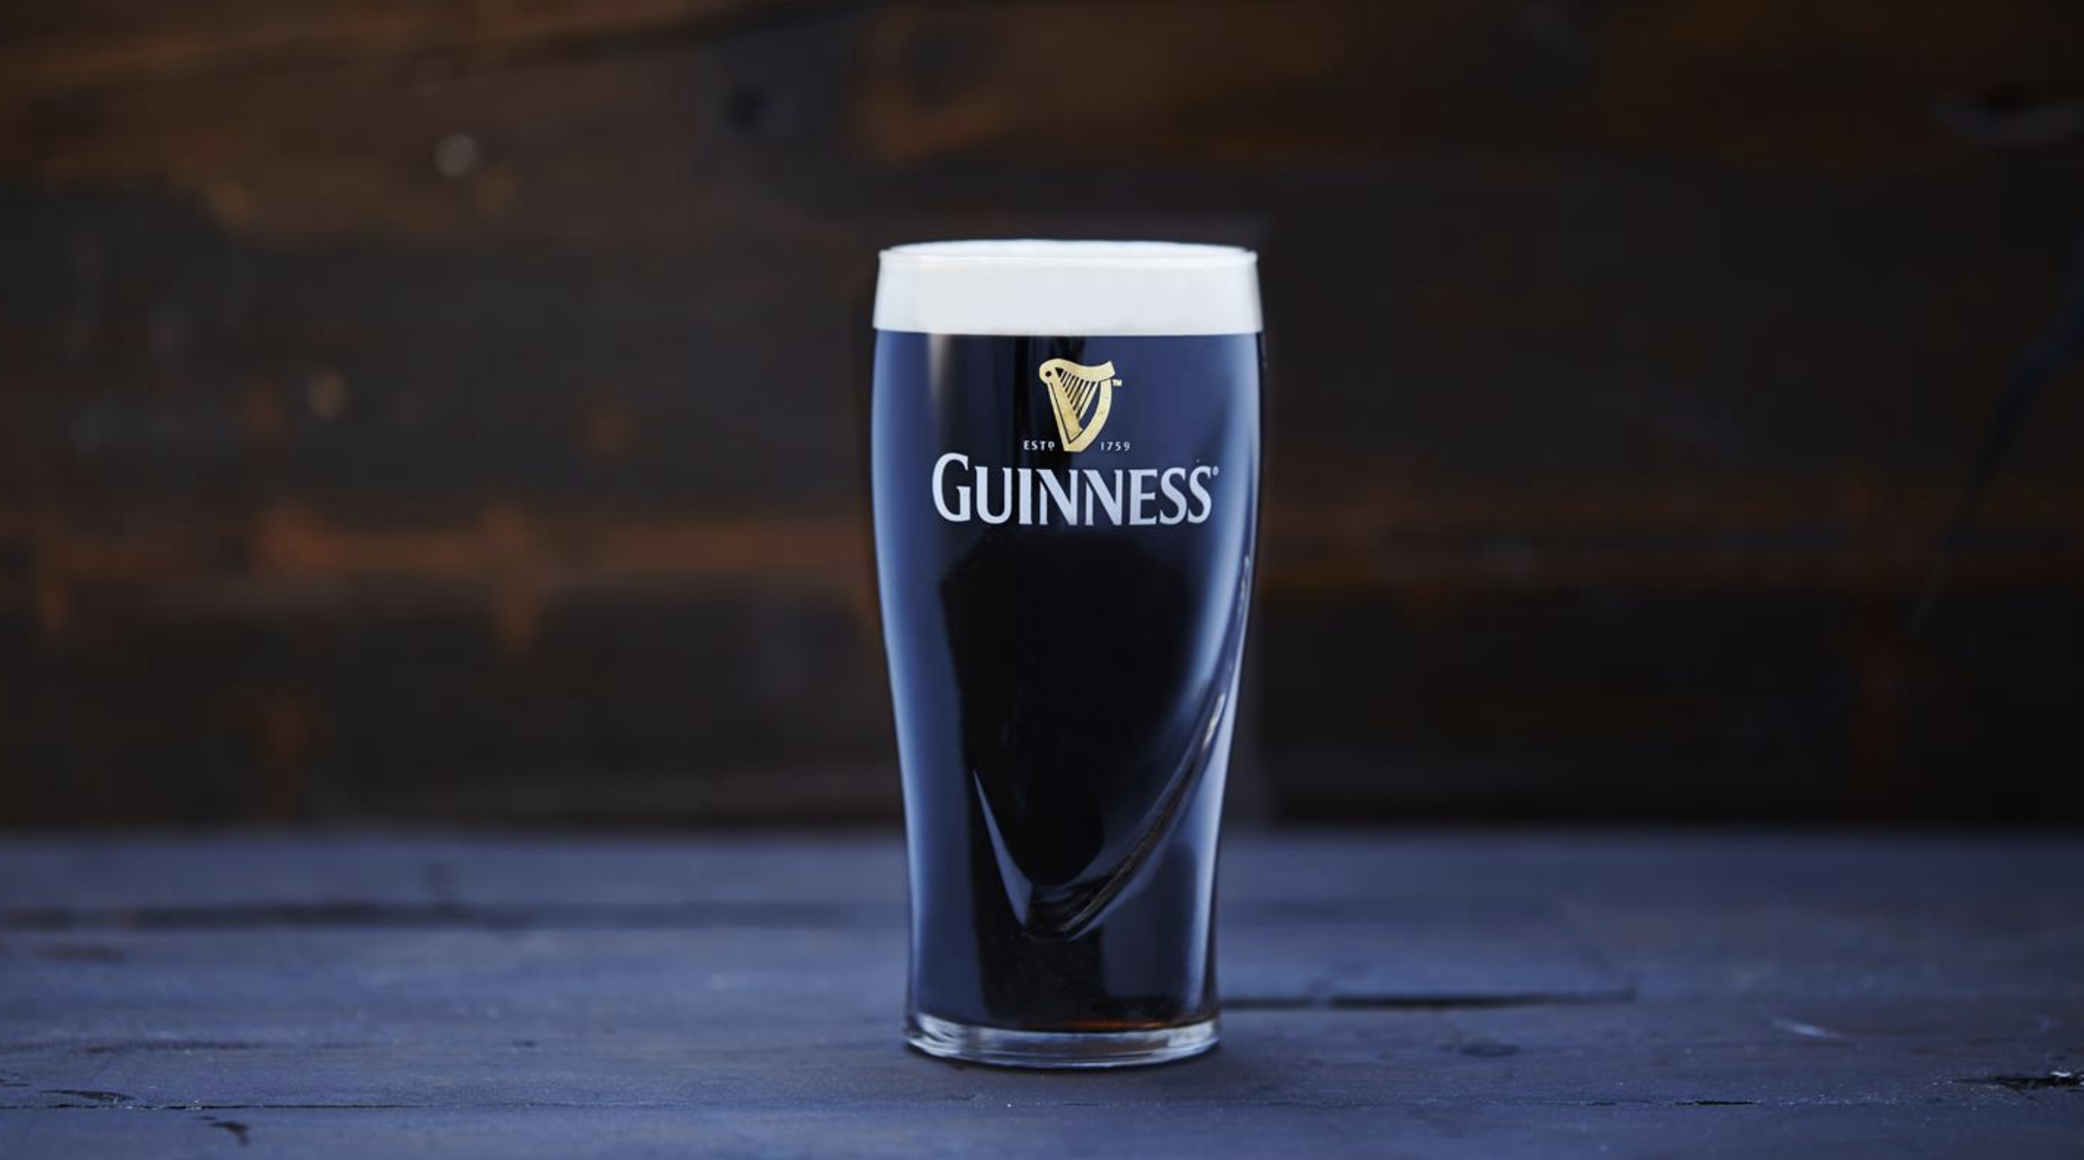
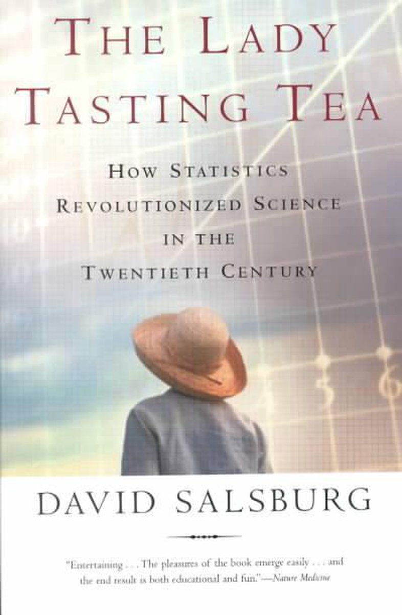
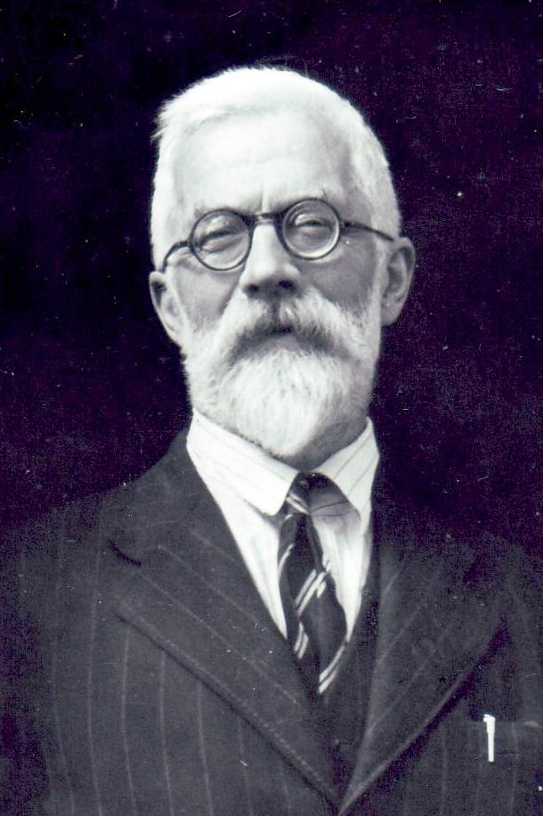
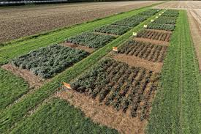
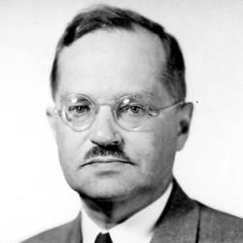
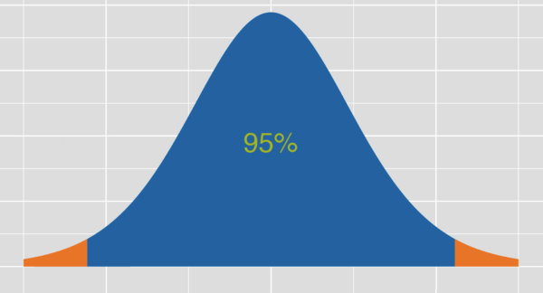
Developments in statistics 1900-1930
Gosset
(Student-T)
Fisher
Neyman

Slide 15
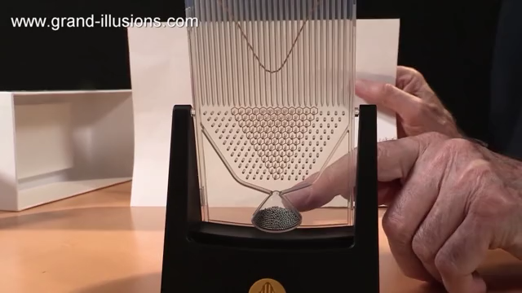
Sampling and the central limit theorem
Galton board
Central limit theorem:
https://gallery.shinyapps.io/CLT_mean/

Slide 16
Sampling and the central limit theorem
Galton board
Central limit theorem:
https://gallery.shinyapps.io/CLT_mean/
The distribution of means that are the result from repeatedly sampling from any population distribution will result in a normal distribution
Law of large numbers: the confidence interval of an estimate from a sample will become smaller the larger the sample size is.

Slide 17
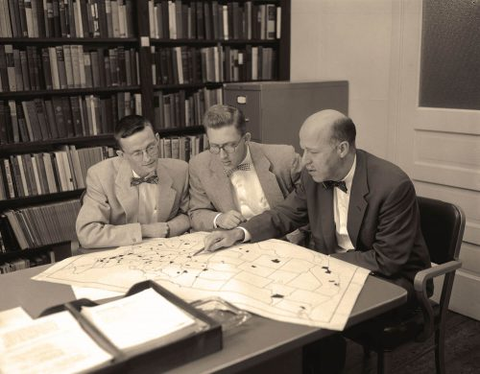
1952 onwards: Michigan election studies
Idea: a random sample from the population
1. Population
2. Frame for population elements
Addresses, phone-numbers, etc.
3. Sample from frame
4. Response from the sample

Slide 18
Design based inference

Slide 19
Elements of design-based inference
Sampling methods: clustering, stratification
Corrections for unequal sampling methods
Hurvitz-Thomposon estimator (1948, 1952) (week 4)
Corrections for missing data: weighting, imputation
Nonresponse (week 8-9,11-12)
Errors on frame (weeks 8,9)
Estimation of uncertainty (errors) (week 3-7)
Variance estimators (week 3-7)
1952-now: development of a framework for inference: design-based

Slide 20
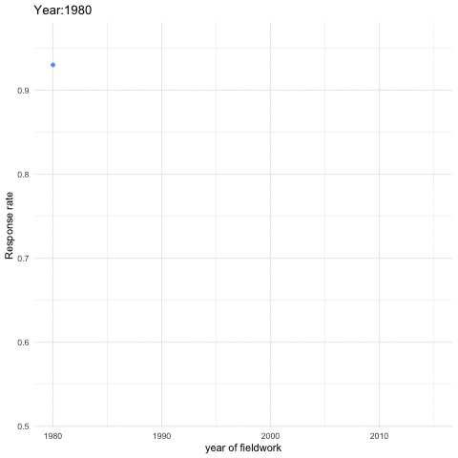
So, what led to the 2nd inference war?
Problems with surveys
Lists are getting worse (telephone esp)
Falling response rates
Costs!

Slide 21
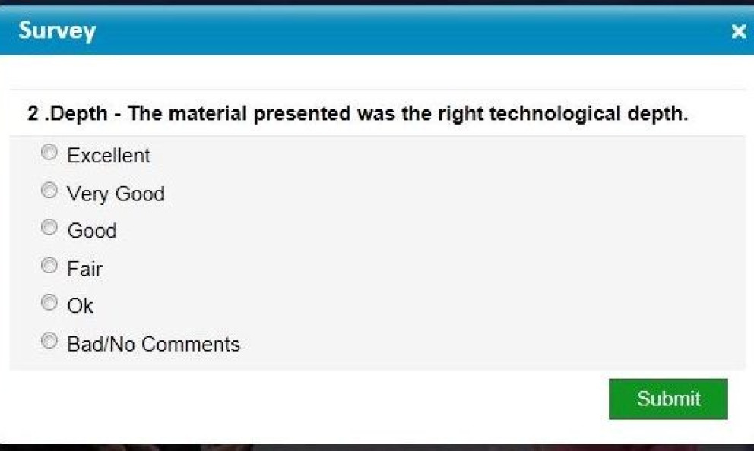
So, what led to the 2nd inference war?
Lists are getting worse
Falling response rates
Costs!
The Internet
Growing need for information
Quick and cheap valued more than slow and expensive

Slide 22
What is the 2nd inference war about?
Design-based inference:
We have worked 60 years to work out sampling theory and survey practice
Methods are unbiased and consistent (week 39)
Using opt-in or quota samples is unscientific
Vs.
Model-based inference:
Response rates are too low
It is just not feasible anymore to do expensive surveys
And a lot of other data is just there!
You need to model nonresponse anyway
Lets model the whole selection process

Slide 23
Election polling
Need for fast results
Can’t be too expensive
Internet panels: quota samples from pre-recruited panel members
Telephone: random digit dialing (USA)
Telephone: registers (phone book)
IVR vs. in-person calls
1000s of polls per election cycle
Polls are generally accurate (see article by Kennedy et al)
But recent high profile misses: US election, British EU-referendum
https://utrecht-university.shinyapps.io/SDA_shinyelectionbias/

Slide 24
Inference peace remains as well: design-based dominant

Slide 25
Class exercise
The 2016 U.S. elections
News stations believed Clinton would easily win
Trump won the election (although lost the popular vote)
Was there a polling miss?
www.fivethirtyeight.com has a database with about1,600 polls conducted before the election
Sample size, company, date conducted, state conducted, reputation of pollster, whole pulation vs. likely voters, raw and adjusted % for Trump and Clinton

Slide 26
Class exercise
Go to https://utrecht-university.shinyapps.io/SDA_shinyelectionbias/
Five groups (4 people each- 20 minutes):
Was Trump underestimated? (or was he particularly in the swing states)?
Did the quality of the pollster matter? (what is quality?)
Was there a difference between sampling likely voters and registered voters?
Are larger polls better?
Is there a difference between raw and adjusted (modeled) poll estimates?

Slide 27
Class exercise (1)
Was Trump underestimated? in the swing states? (Michigan, Wisconsin, Pensylvania)

Slide 28
Class exercise (2)
Did the quality of the pollster matter?

Slide 29
Class exercise (3)
Was there a difference between sampling likely voters and registered voters?

Slide 30
Class exercise (4)
Are larger polls better?

Slide 31
Class exercise (5)
Is there a difference between raw and modeled polls?

Slide 32
Next week: Total survey error
We move into design-based surveys
Read articles
Complete take-home exercise and bring to class
THE 1- Your adopted survey.

